Slide 1
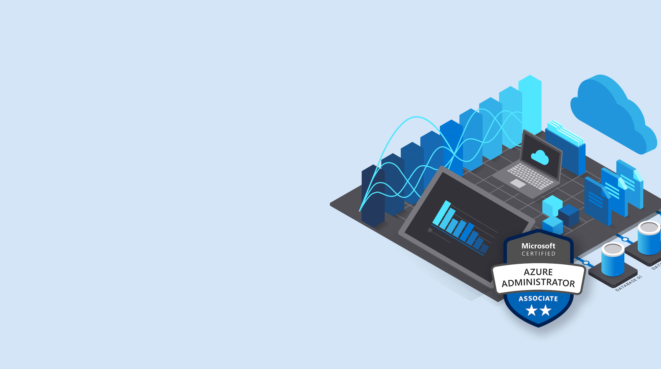
Microsoft Azure Administrator
Maruti Makwana
MCT Corporate Trainer
https://www.linkedin.com/in/marutimakwana/
13th June 2025

Slide 2

Configure Azure Container Instances Apps

Slide 3
Compare Containers to Virtual Machines
Isolation
Operating System
Deployment
Persistent storage
Fault tolerance
Container
Container
VM
VM
App A
App B
App A
App A
App B
App B
Bins/Libs
Bins/Libs
Bins/Libs
Bins/Libs
Guest OS
Guest OS
Docker Engine
Hypervisor
Host OS
Server
Notes:
Containers vs. virtual machines https://learn.microsoft.com/virtualization/windowscontainers/about/containers-vs-vm

Slide 4
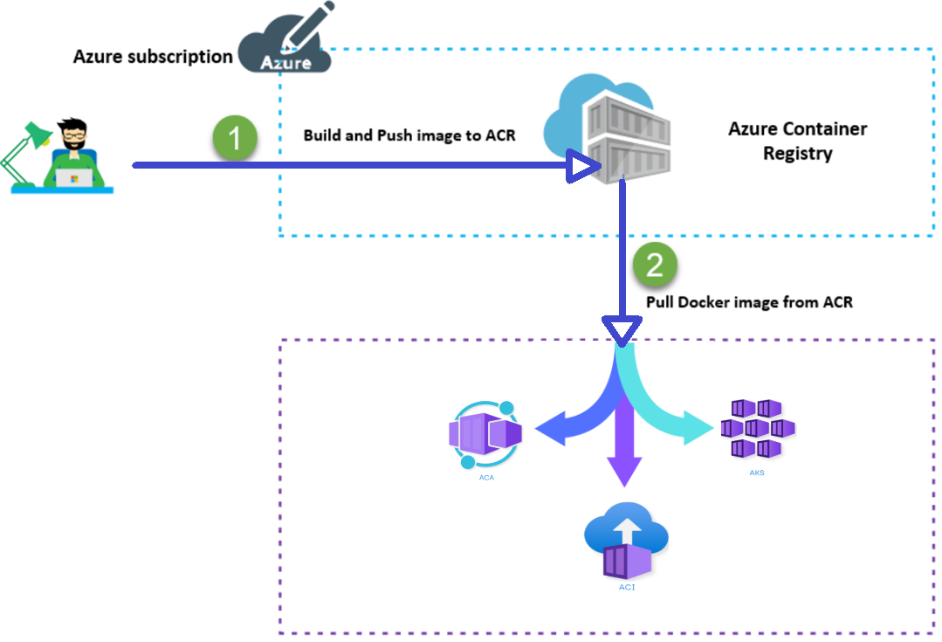
Understand Container Images
A container image is a lightweight, standalone, executable package of software that encapsulates everything needed to run an application.

Slide 5
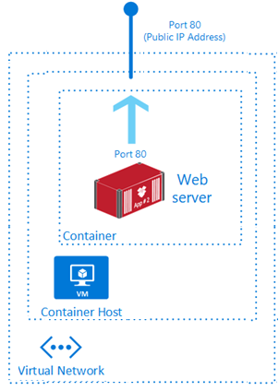
Review Azure Container Instances
PaaS Service
Fast startup times
Public IP connectivity and DNS name
Isolation features
Custom sizes
Persistent storage
Linux and Windows Containers
Co-scheduled Groups
Virtual network Deployment
Fastest way to run a container in Azure without provisioning a VM
Notes:
What is Azure Container Instances?
https://learn.microsoft.com/azure/container-instances/container-instances-overview

Slide 6
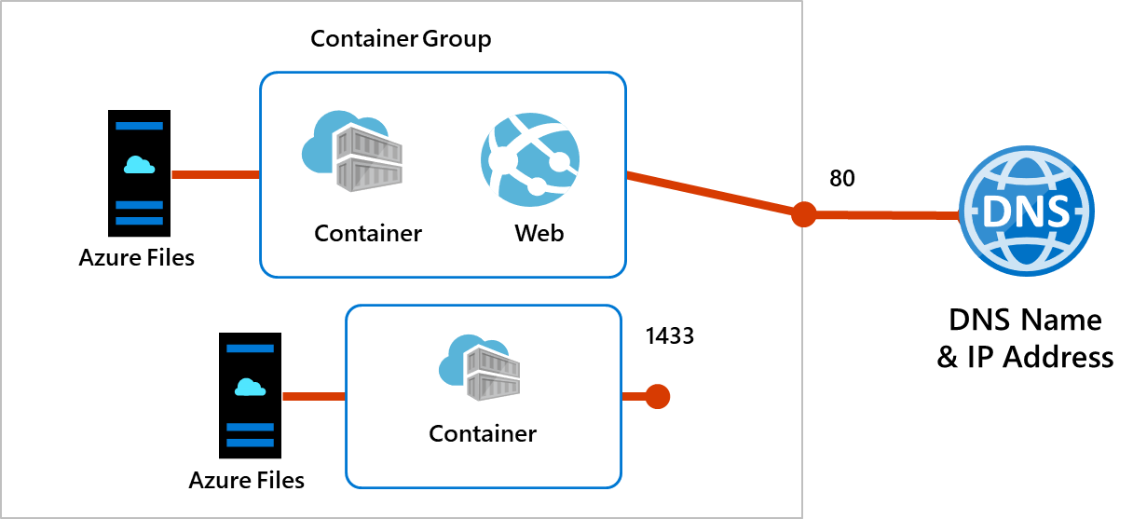
Implement Container Groups
Top-level resource in Azure Container Instances
A collection of containers that get scheduled on the same host
The containers in the group share a lifecycle, resources, local network, and storage volumes
Notes:
Container groups in Azure Container Instances
https://learn.microsoft.com/azure/container-instances/container-instances-container-groups
Quickstart: Deploy a container instance in Azure using the Azure portal https://learn.microsoft.com/azure/container-instances/container-instances-quickstart-portal

Slide 7
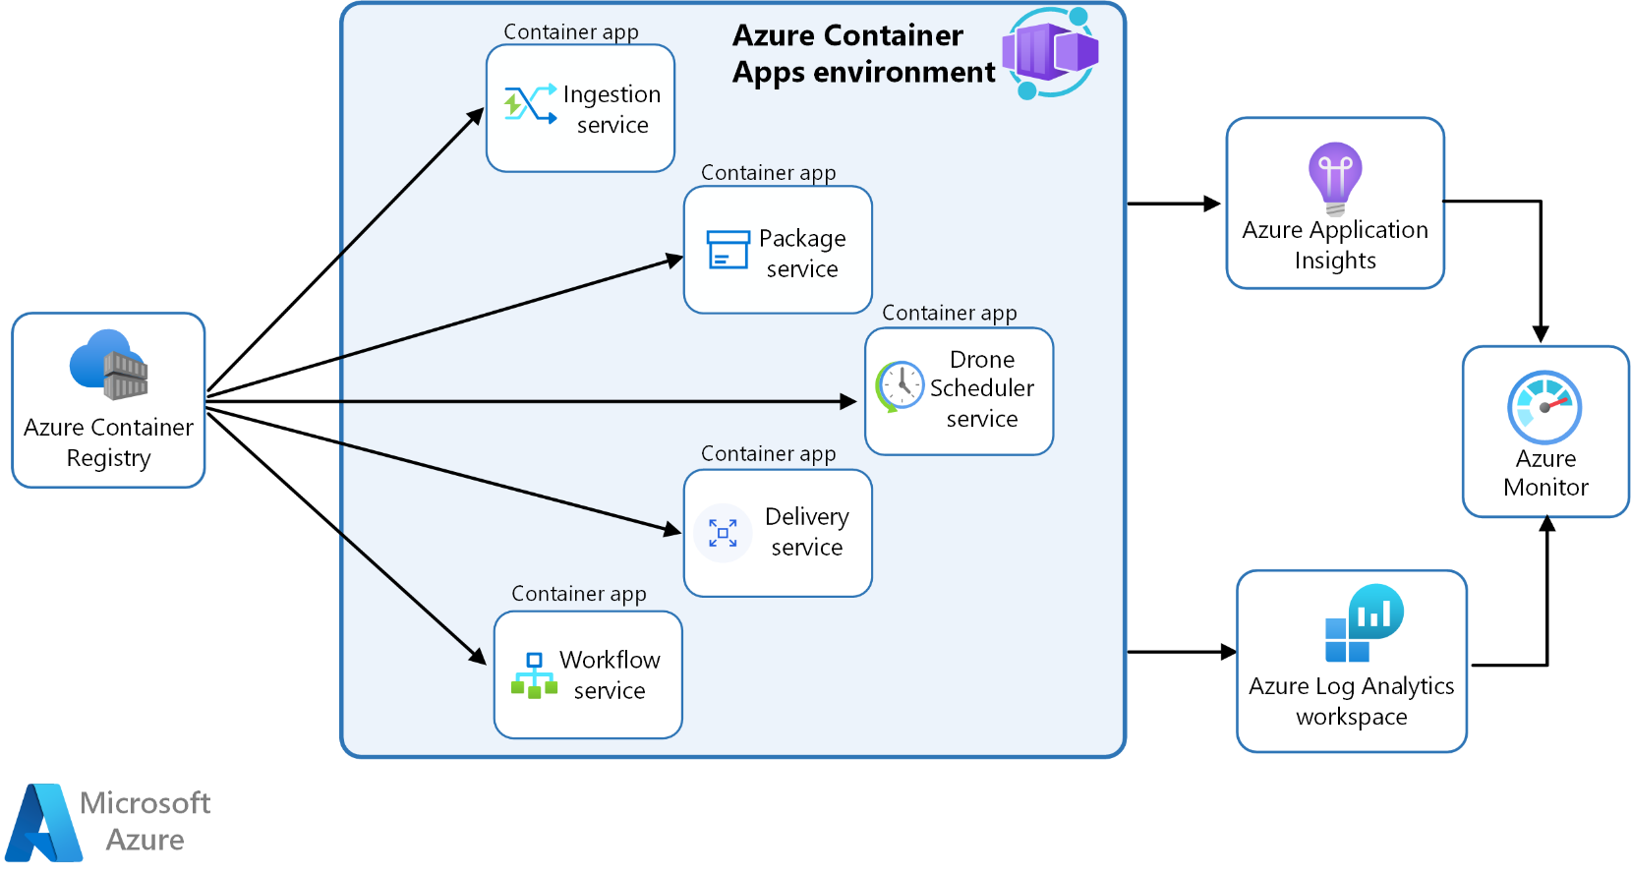
Manage Containers with Azure Container Apps
Alternative to Azure Kubernetes Service – manages container orchestration
The Container App environment creates a secure boundary around the apps and jobs
The Container App runtime manages the environment (OS upgrades, scaling, versioning, and failover)
Notes:
Deploy microservices with Azure Container Apps - https://learn.microsoft.com/azure/architecture/example-scenario/serverless/microservices-with-container-apps
Azure Container Apps documentation
https://learn.microsoft.com/azure/container-apps/

Slide 8
Compare container management solutions
 | Azure Container Apps | Azure Kubernetes Service
Overview | Simplifies the deployment and management of microservices-based applications by abstracting away the underlying infrastructure. | Simplifies deploying a managed Kubernetes cluster in Azure by offloading the operational overhead to Azure.
Deployment | PaaS experience. | Offers more control and customization.
Management | Fully managed by Azure. | Partially managed by Azure (control plane).
Scalability | HTTP-based autoscaling and event-driven scaling. | Horizontal pod autoscaling and cluster autoscaling.
Use Cases | Rapid scaling and simplified management. | Complex, long-running applications that require full Kubernetes features.
Integration | Azure Logic Apps, Functions, and Event Grid for event-driven architecture. | Azure Policy for Kubernetes, Azure Monitor for containers, and Azure Defender for Kubernetes for comprehensive security and governance.
Notes:
Comparing Container Apps with other Azure container options
https://learn.microsoft.com/azure/container-apps/compare-options

Slide 9
Protect your virtual machines by using Azure Backup

Slide 10
Explore options to protect virtual machine data
Snapshots
Azure Backup
Azure Site Recovery
Managed snapshots provide a quick and simple option for backing up VMs that use Managed Disks
Azure Backup supports application-consistent backups for both Windows and Linux VMs
Azure Site Recovery protects your VMs from a major disaster scenario when a whole region experiences an outage
Notes:
An overview of Azure VM backup
https://learn.microsoft.com/azure/backup/backup-azure-vms-introduction
✔️ Have you tried any of these backup methods? Do you have a backup plan?

Slide 11
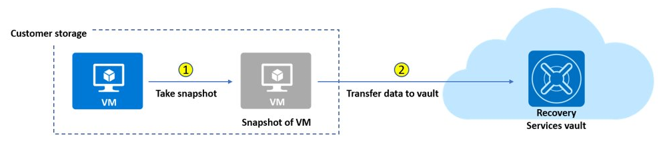
Create virtual machine snapshots in Azure Backup
Use snapshots taken as part of a backup job
Reduces recovery wait times – don’t wait for data transfer to the vault to finish
Configure Instant Restore retention (standard or enhanced)
Notes:
Create a snapshot
https://learn.microsoft.com/azure/virtual-machines/windows/snapshot-copy-managed-disk

Slide 12
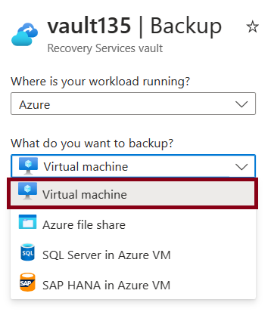
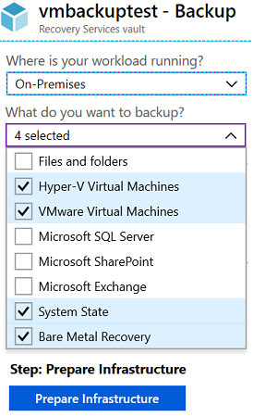
Set up Azure Recovery Services vault backup options
Multiple servers can be protected using the same Recovery Services vault
Azure Workloads
On-Premises Workloads

Slide 13
Backup Virtual Machines
Create a recovery services vault
Use the Portal to define the backup
Backup the virtual machine
1
2
3
Use a Recovery Services Vault in the region where you are performing your Virtual Machine backups and choose a replication strategy for Vault
Take snapshots (recovery points) of your data at defined intervals. These snapshots are stored in recovery services vaults
For the Backup extension to work, the Azure VM Agent must be installed on the Azure virtual machine
Notes:
Tutorial: Back up and restore files for virtual machines in Azure https://learn.microsoft.com/azure/virtual-machines/windows/tutorial-backup-vms

Slide 14
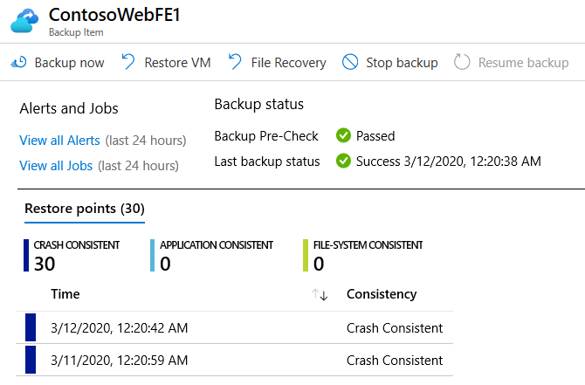
Restore Virtual Machines
Once you trigger the restore operation, the Backup service creates a job for tracking the restore operation
The Backup service also creates and temporarily displays notifications, so you monitor how the backup is proceeding

Slide 15
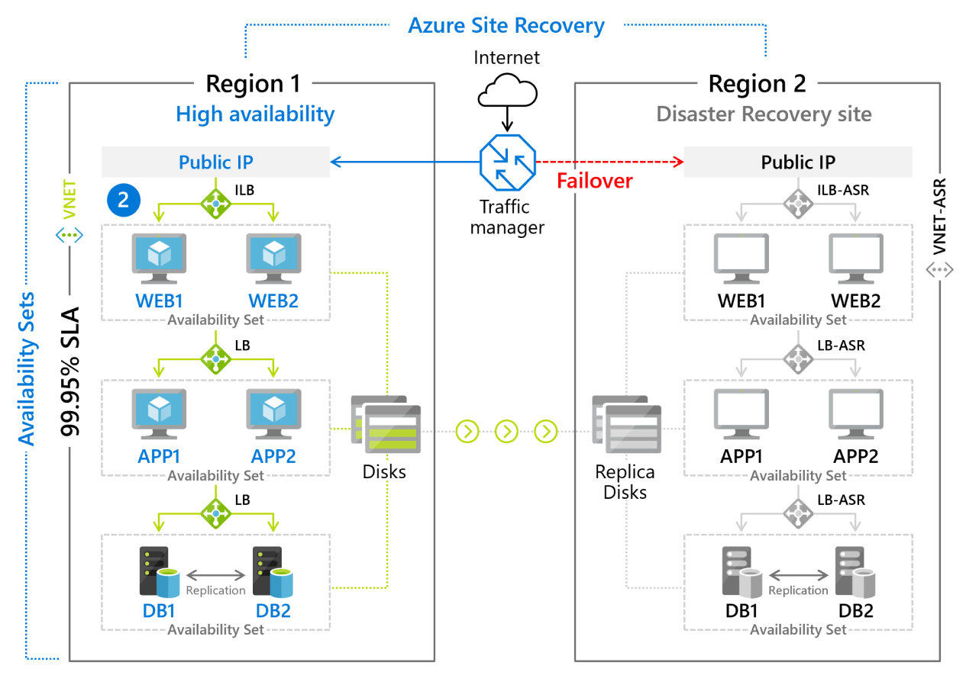
Manages the orchestration of disaster recovery
Replicates workloads continuously from a primary location or region to a secondary location
Failover to shift to the secondary location; failback to return to the primary location
Implement Azure Site Recovery
Notes:
Azure Site Recovery documentation
https://learn.microsoft.com/azure/site-recovery/
Concentrate on replication within Azure and not migration scenarios from on-premises.

